Slide 1
Starbucks Nutrition Insights
Data Storytelling for Executives

Slide 2
Introduction
Consumer health awareness is rising. Starbucks plays a key role in the daily habits of millions.
Executives need to understand how menu items align with health trends.
Question: How do calories and sugar vary across Starbucks drinks?

Slide 3
Key Questions
- What is the average sugar content by drink type?
- Which categories are highest in calories?
- How many drinks exceed daily sugar recommendations?
- What opportunities exist for healthier menu positioning?

Slide 4
Data Exploration
Dataset: Starbucks Nutrition Facts
- Variables: Calories, Sugar, Fat, Protein, Category
- Approach: Compare across categories (coffee, tea, frappuccino, etc.)
- Methods: Averages, comparisons, scatter plots

Slide 5
Key Findings
1. Frappuccinos contain the highest average sugar levels.
2. Many drinks exceed WHO daily sugar intake in a single serving.
3. Brewed coffee and teas are the lowest-calorie options.
4. Strong correlation between sugar and total calories.

Slide 6
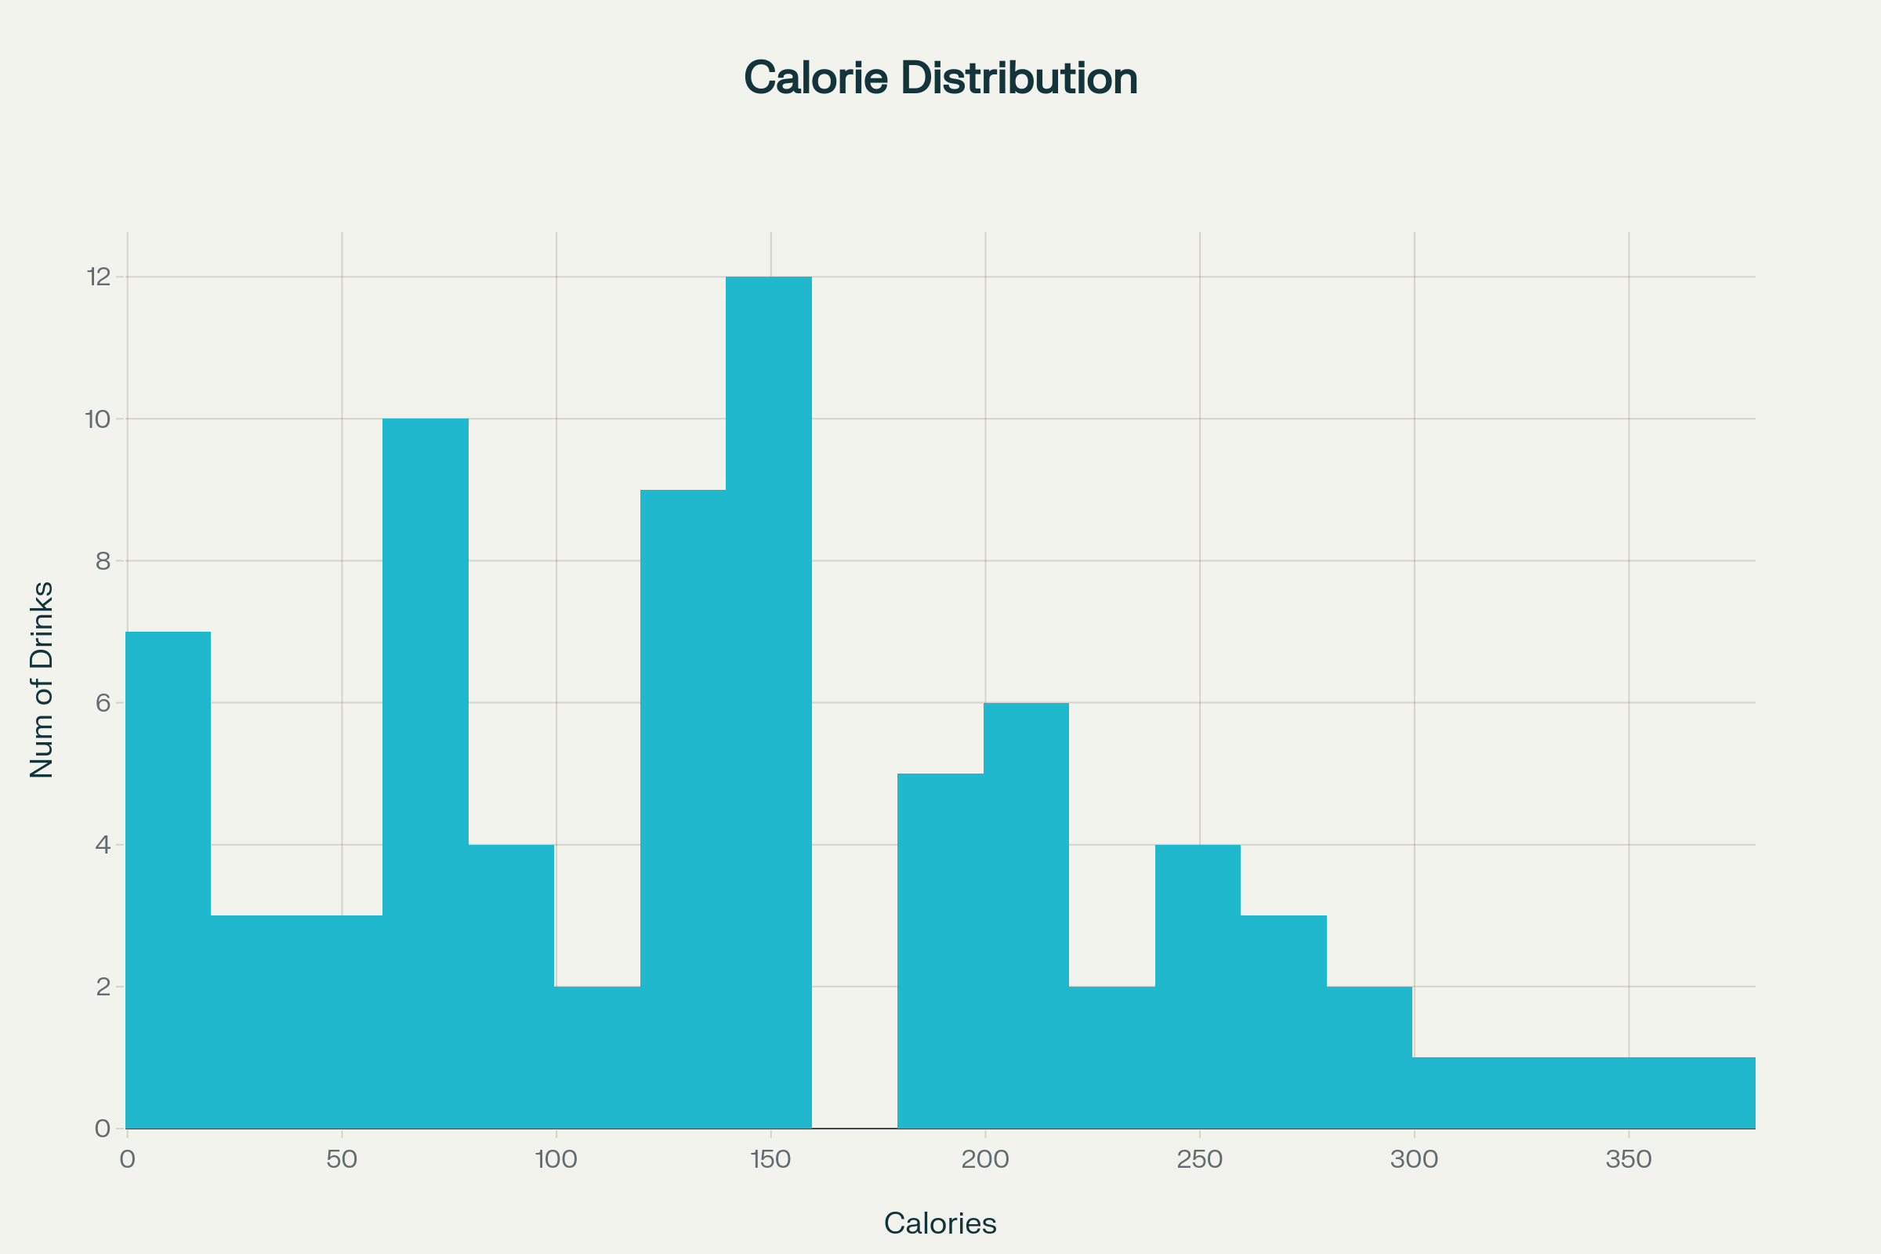
Visual Insights

Slide 7
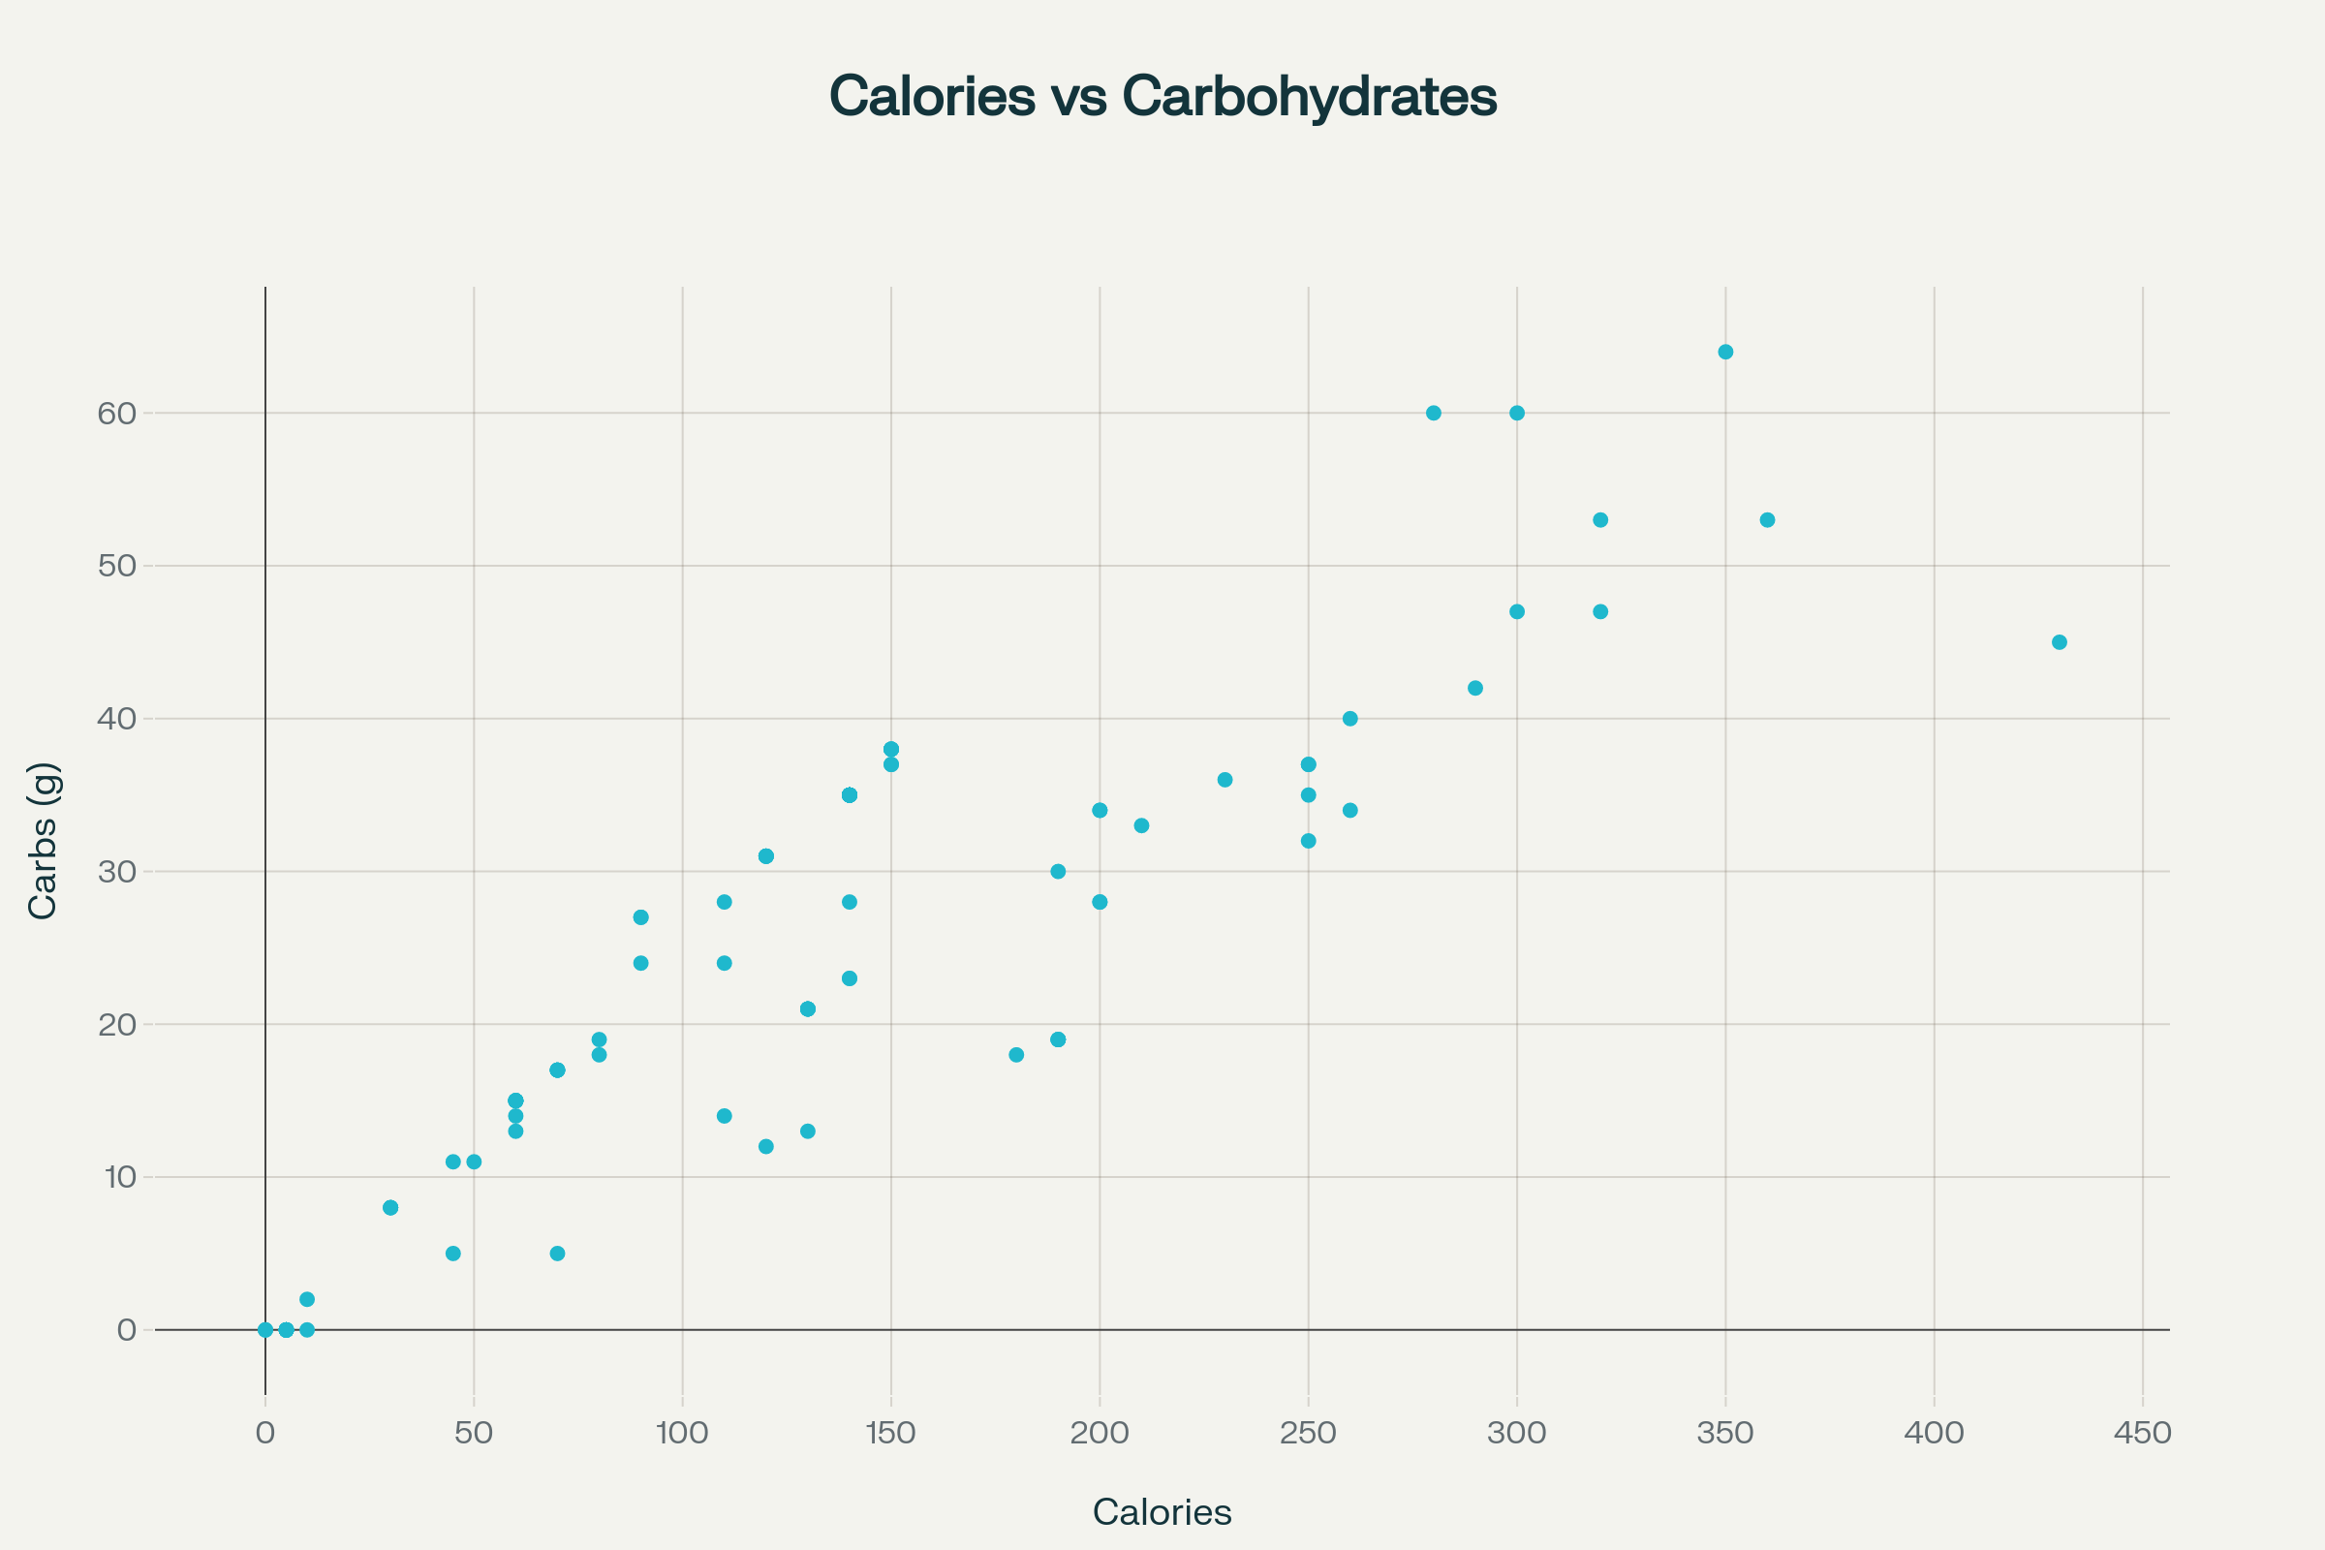

Slide 8
Executive Insights
- Starbucks menu includes high-calorie, high-sugar beverages.
- Health-conscious customers may view this as a risk.
- Significant opportunity to market and expand lower-sugar, lower-calorie options.

Slide 9
Recommendations
1. Introduce and promote low-sugar beverage lines.
2. Highlight existing healthier options in marketing.
3. Provide clear nutritional info to empower consumers.
4. Align product innovation with global health trends.

